Slide 1


MCM
Rule Engine for Sharjah Islamic Bank
-Training Document

Slide 2
Agenda
Rule Engine overview
Parameter Management
Rules Management
Rules
Rule Utility
Group Rules
Simulator
Role Management
User Management
Reports

Slide 3
Rule Engine overview
Parameter Management
Rules Management
Rules
Rule Utility
Group Rules
Simulator
Role Management
User Management
Reports

Slide 4
Rule Engine Overview
The Rule Engine enables policies or operational decisions to be defined, tested, executed and maintained separately from Application code.
Rule Engine has a web-based component specifically designed to aid Business team, developers or support engineers to do easy configuration and for the easy change management process

Slide 5
The Golden Circle of SmartRules
Why SmartRules?
Reducing complex change management across channels.
Brings decision consistencies and compliance across channels.
API integration for any channels/interface to consume.
Quick and easy to configure business rules.
How SmartRules helps?
Bringing automation to the decision-making processes.
Personalized and hassle-free customer experience.
Increase revenue by cross sell upsell opportunities.
Improved customer retention and engagement.
Enhance productivity and efficiency enterprise wide.
Why
What is SmartRules?
A No-Code system that helps Enterprises to host all the business rule in a centralized place and extend to any of the customer touchpoints seamlessly.
It provides integration to enterprise applications like mobile app, web, Call center, back-office and any other self-service channels through API’s.
How
What

Slide 6











Customers
Customer
Touchpoints
Customer Facing Users
Backoffice Users
Digital Workforce
Self Service
SmartRules

Slide 7
Rule Engine overview
Parameter Management
Rules Management
Rules
Rule Utility
Group Rules
Simulator
User Management
Role Management
Reports

Slide 8
Parameter Management
Add New Parameter
Load Parameters
Parameters approval Screen

Slide 9
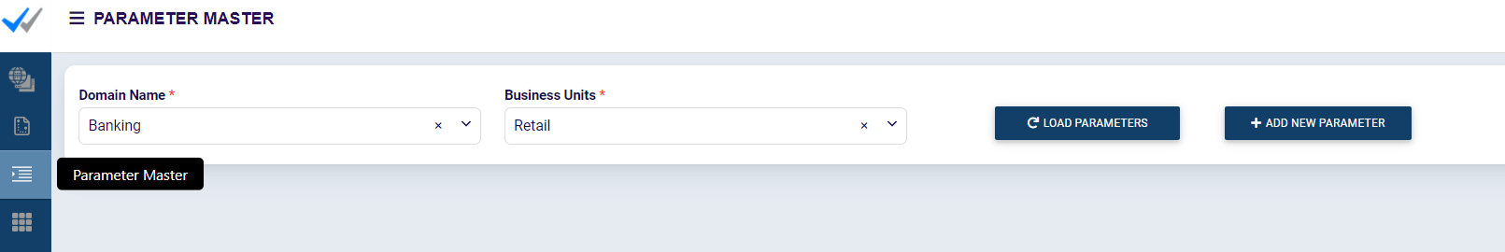
Parameter Management
The parameters required for defining the Rules can be configured here
The Parameters created will be sent for approval once created.
Approved Parameters will be available for Rule Creation

Slide 10
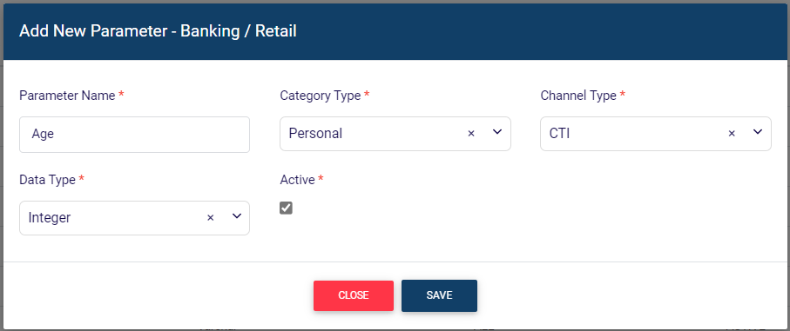
Parameter Management – Add new Parameter
Choose Add New Parameter to create a New Parameter
Parameters can be of types Varchar, Integer, Boolean, Date, Date & Time and List
Once Parameters are created it will be sent for approval

Slide 11
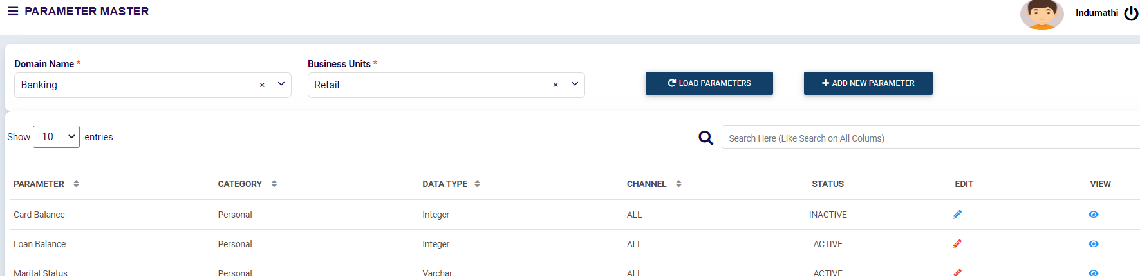
Parameter Management – Load Parameters
Provide Domain Name and Business unit Click on Load Parameters. The list of approved Parameters will be listed.

Slide 12
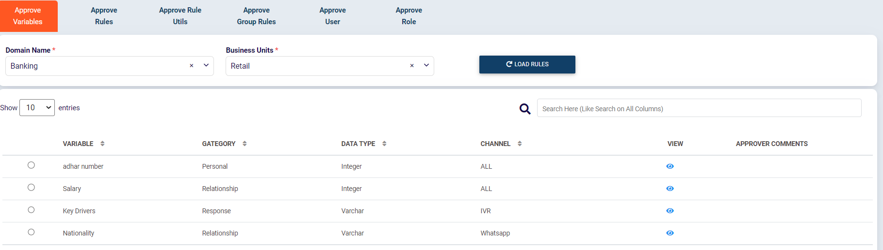
Parameter Management – Parameters Approval
Provide Domain Name and Business unit Click on Load Parameters.
The list of Parameters sent for approval will be listed.

Slide 13
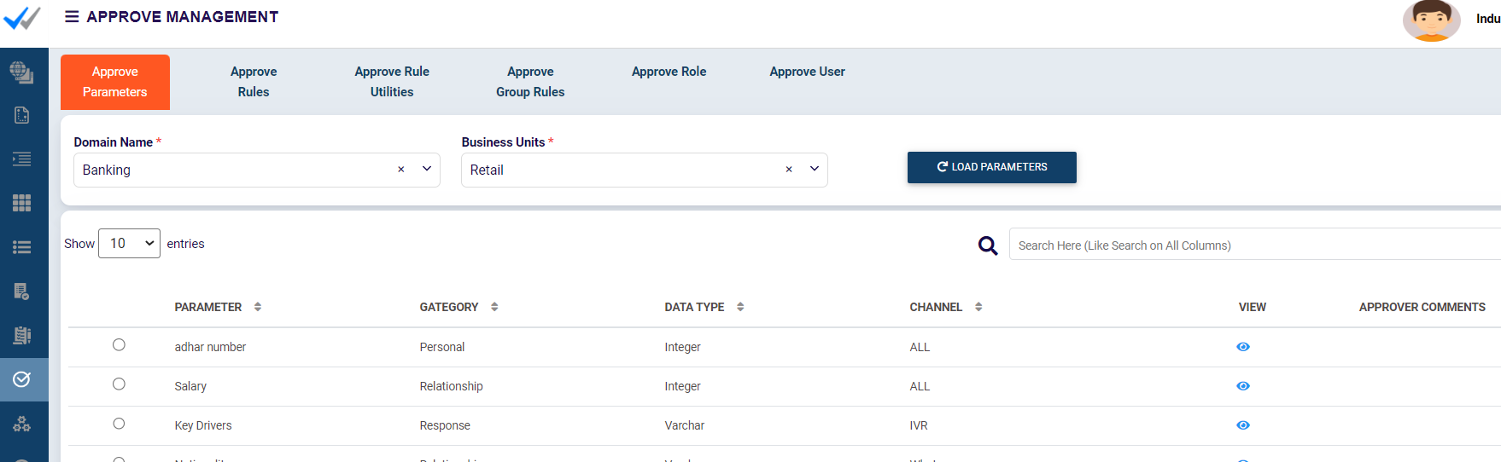
Parameter Management – Parameters Approval
Checker can verify the details of the Parameter and he can approve /reject the Parameters

Slide 14
Rule Engine overview
Parameter Management
Rules Management
Rules
Rule Utility
Group Rules
Simulator
Role Management
User Management
Reports

Slide 15
Rules
Define Rules Screen
Create Rules
Load Rules
Rule Approval Screen
Approved Rules Screen

Slide 16
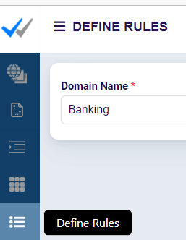
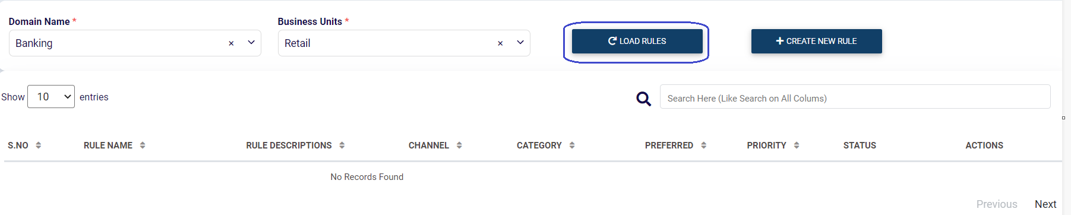
Define Rules
Rules can be defined by “Define Rules”
Load Rules lists the unapproved Rules

Slide 17
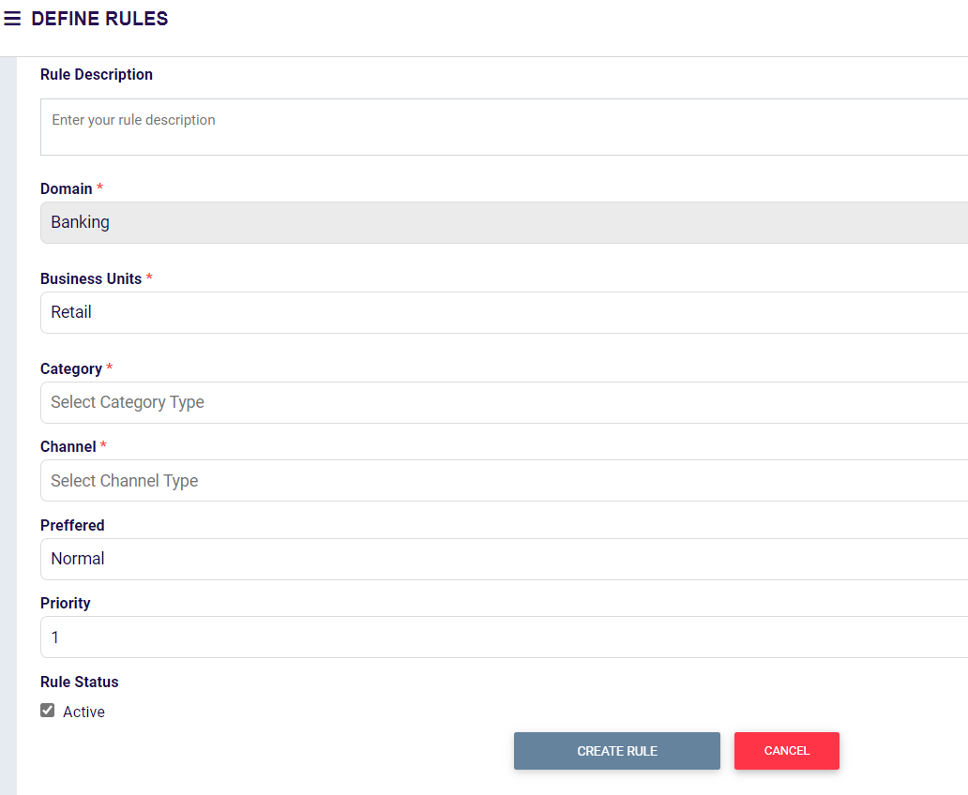
Create Rules – Initial Configuration
Initial configuration for Rule is done here
You can configure Rule Name

Slide 18
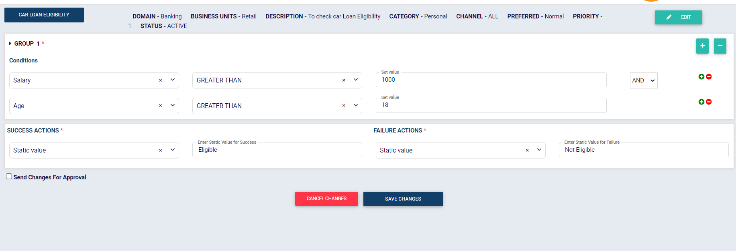
Create Rules – Define Rule

Slide 19
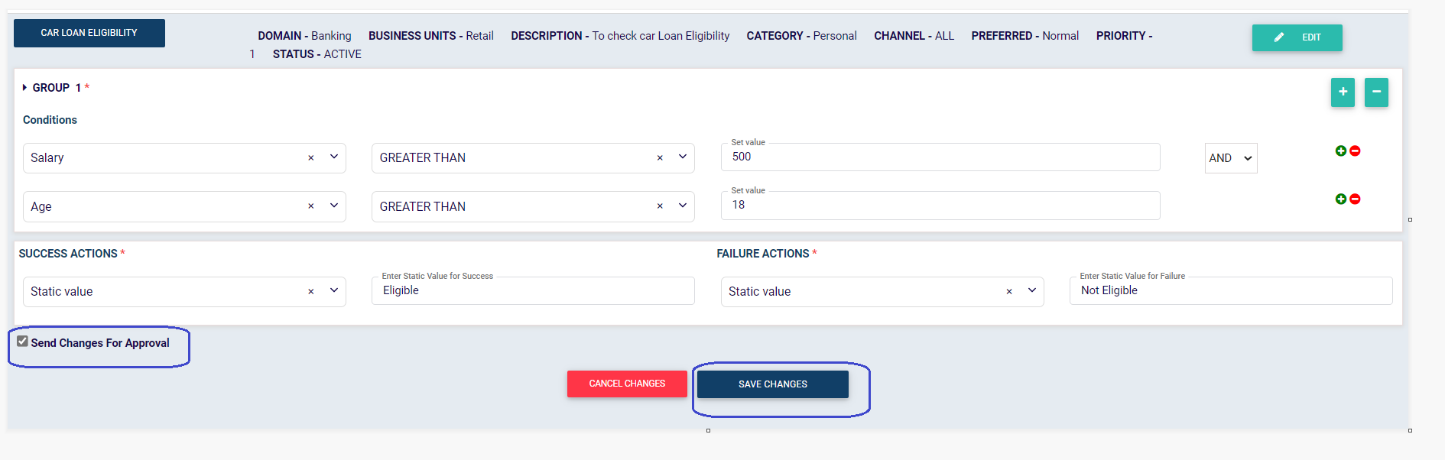
Create Rules – Send for Approval

Slide 20
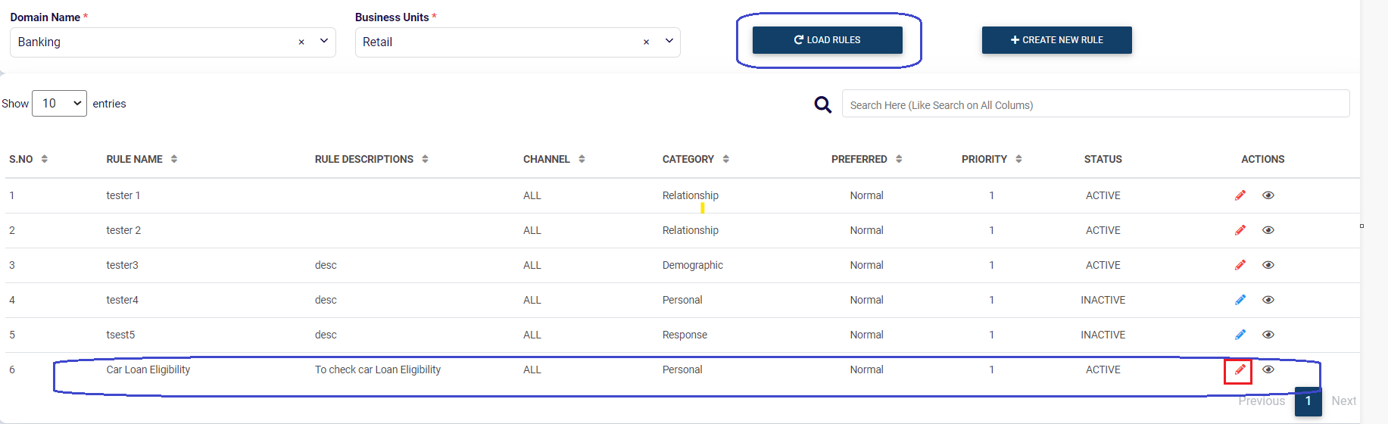
Create Rules – Load Rules

Slide 21
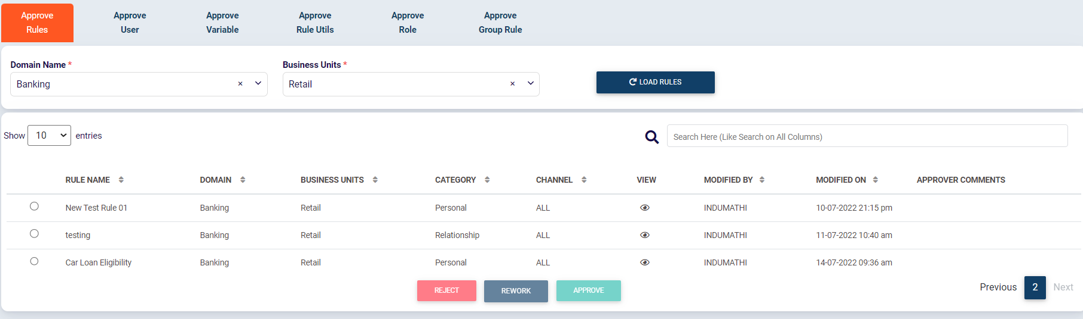
Rule Approval Screen
Approver can view the Rules shared for approval
He can choose any of 3 options [ approve/Reject/Rework]

Slide 22
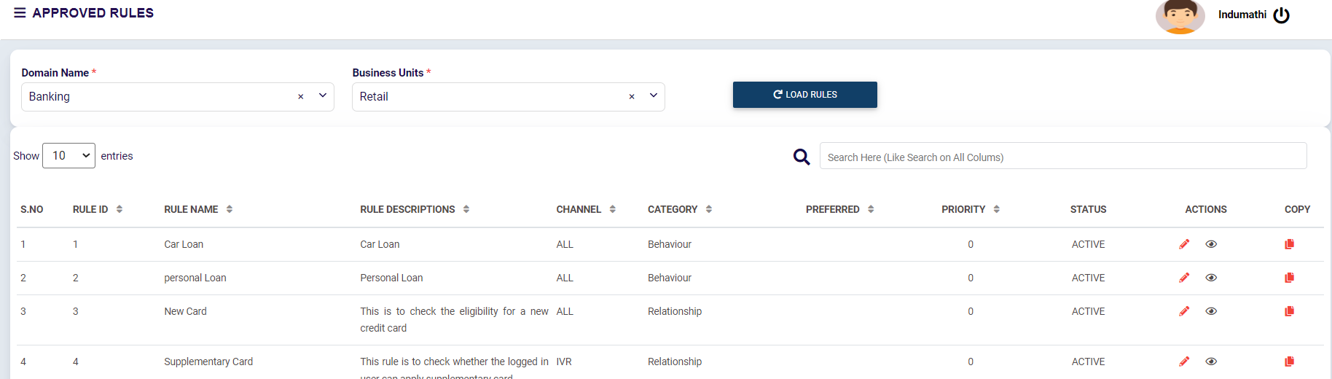
Approved Rules Screen
All approved Rules can be viewed in Approved Rules Screen
This can be further edited and send for approval

Slide 23
Rule Engine overview
Parameter Management
Rules Management
Rules
Rule Utility
Group Rules
Simulator
Role Management
User Management
Reports

Slide 24
Rule Utility
Create Rule Utility
Approve Rule Utility
Approved Rule Utility Screen

Slide 25
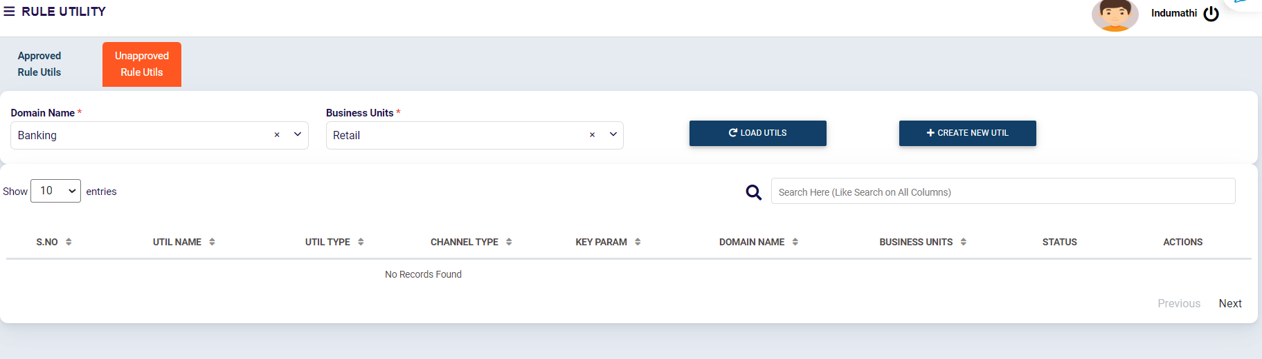
Rule Utility – Create New Rule Utility

Slide 26
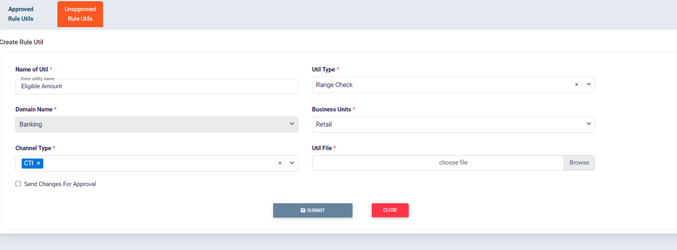
Rule Utility - Create New Rule Utility

Slide 27
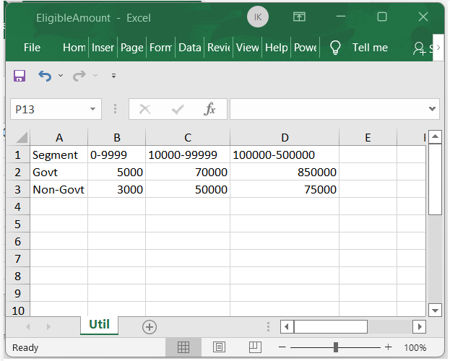
Rule Utility – Create Rule Utility-Sample Excel

Slide 28
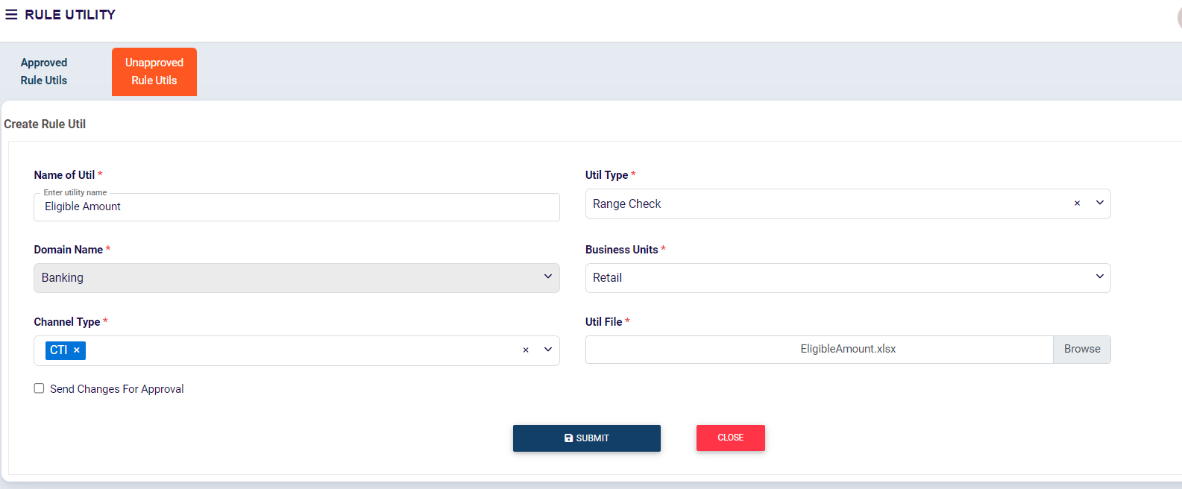
Rule Utility – Create Rule Utility–upload excel

Slide 29
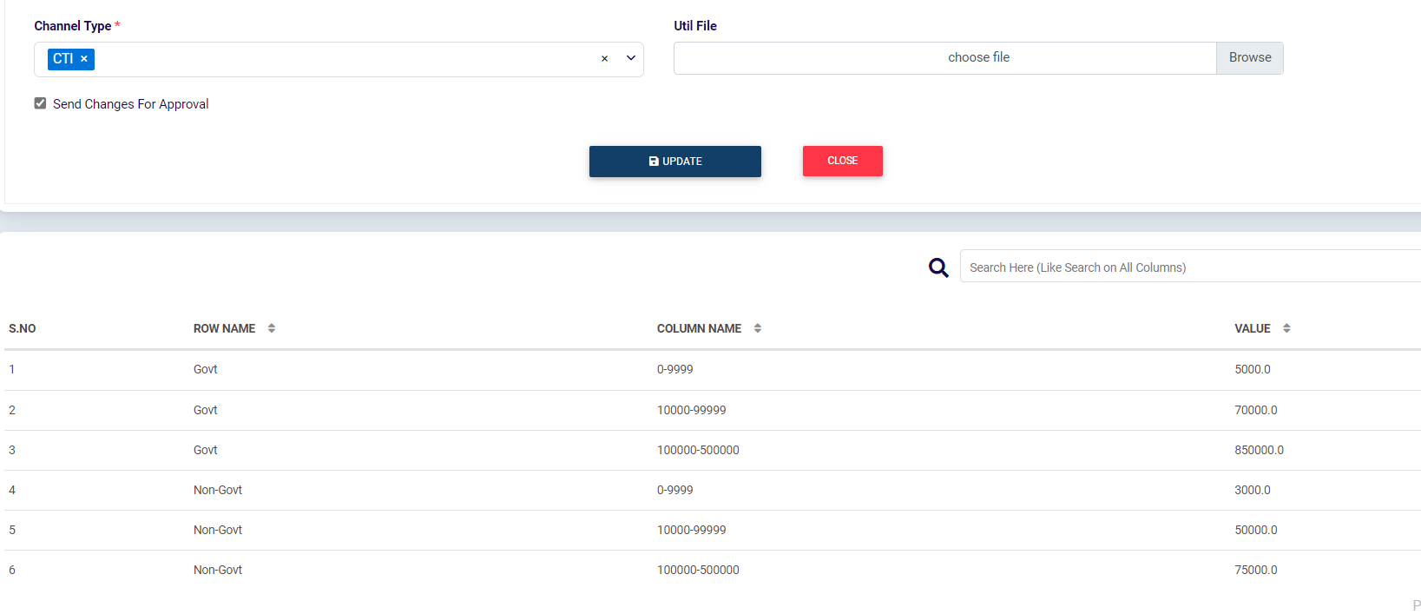
Rule Utility – Send for Approval

Slide 30
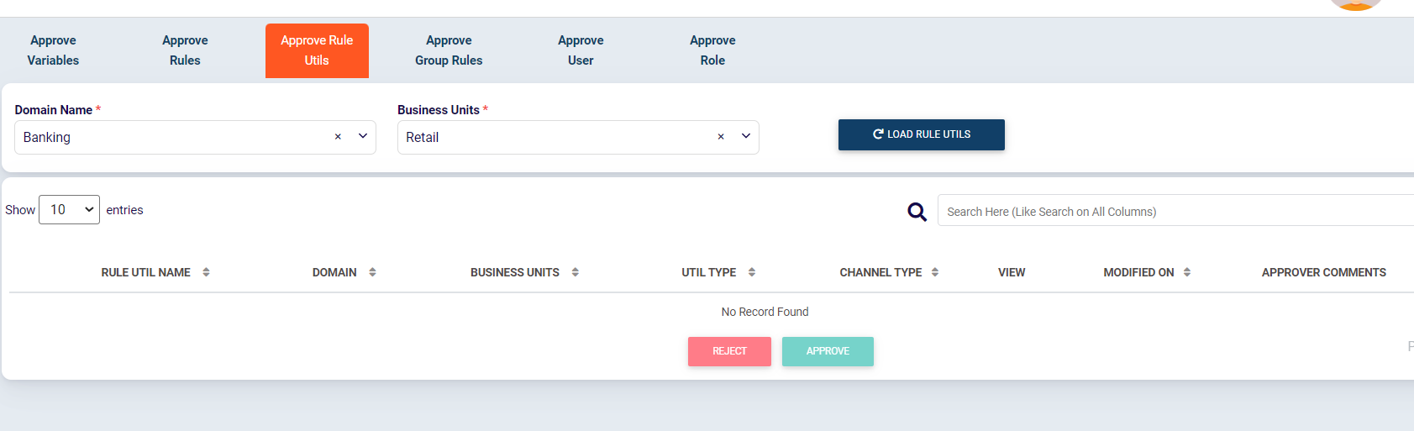
Rule Utility – Approve Rule Utility
The list of Rule Utilities sent for approval can be approved /rejected by the user having checker privileges

Slide 31
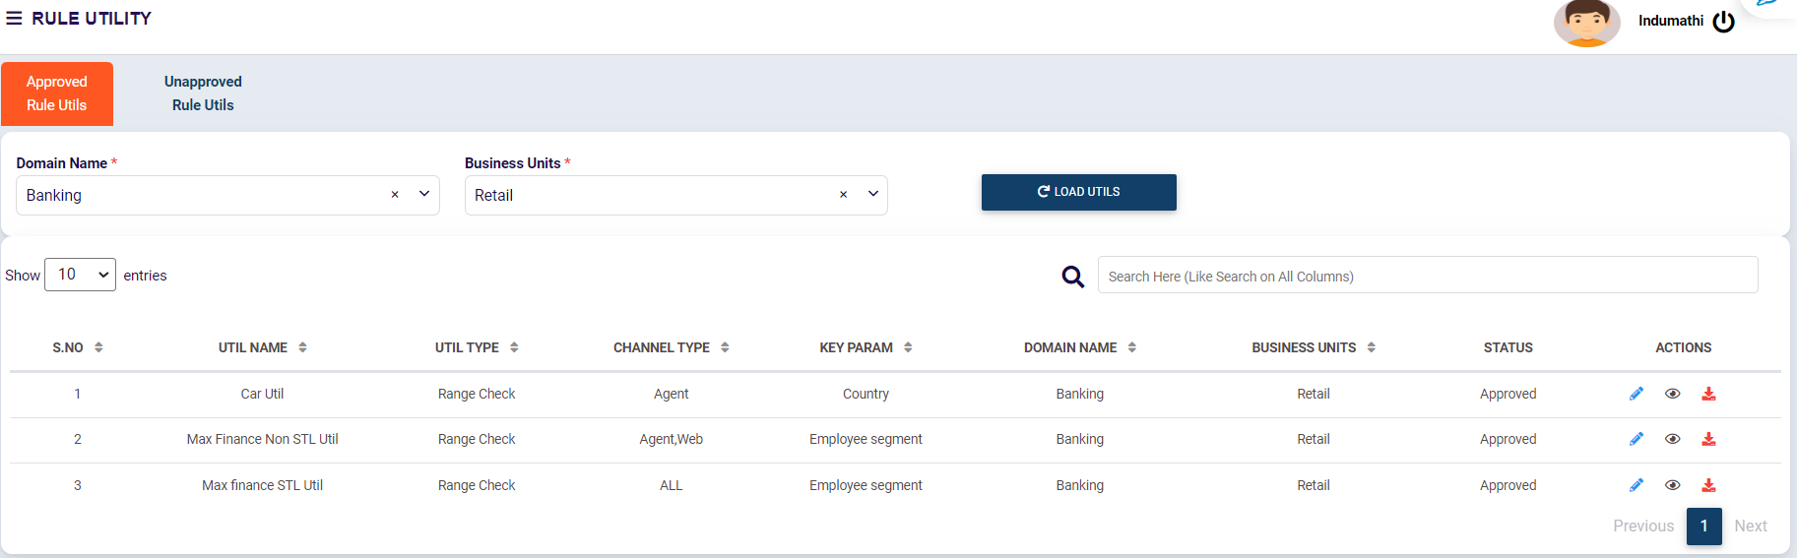
Rule Utility – Approved Rule Utils

Slide 32
Rule Engine overview
Parameter Management
Rules Management
Rules
Rule Utility
Group Rules
Simulator
Role Management
User Management
Reports

Slide 33
Group Rules
Create New Group Rule
Approve Group Rule

Slide 34
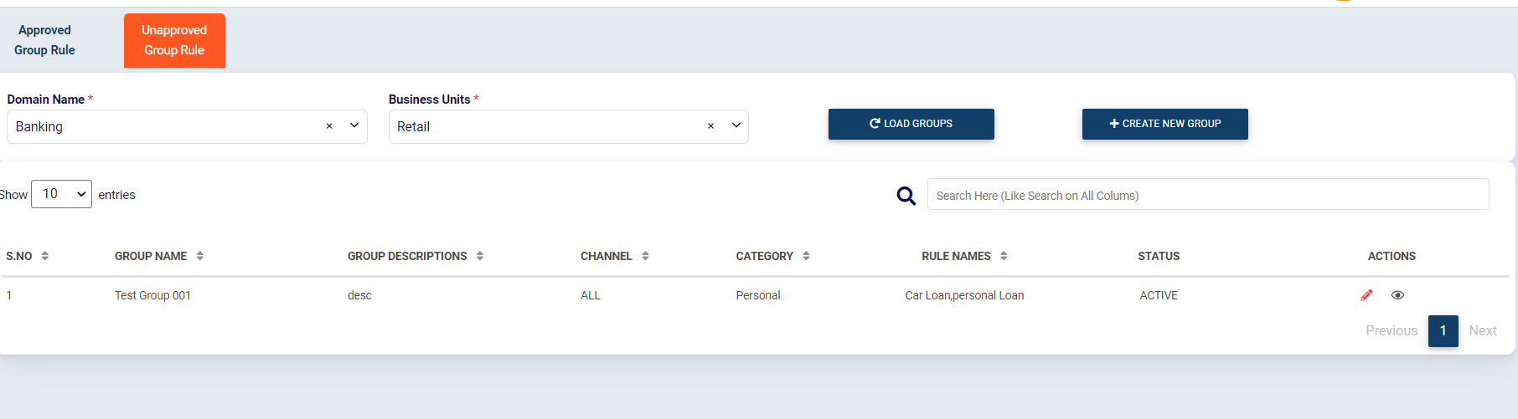
Group Rules
Rules that are created and approved can be Grouped together By Group Rules

Slide 35
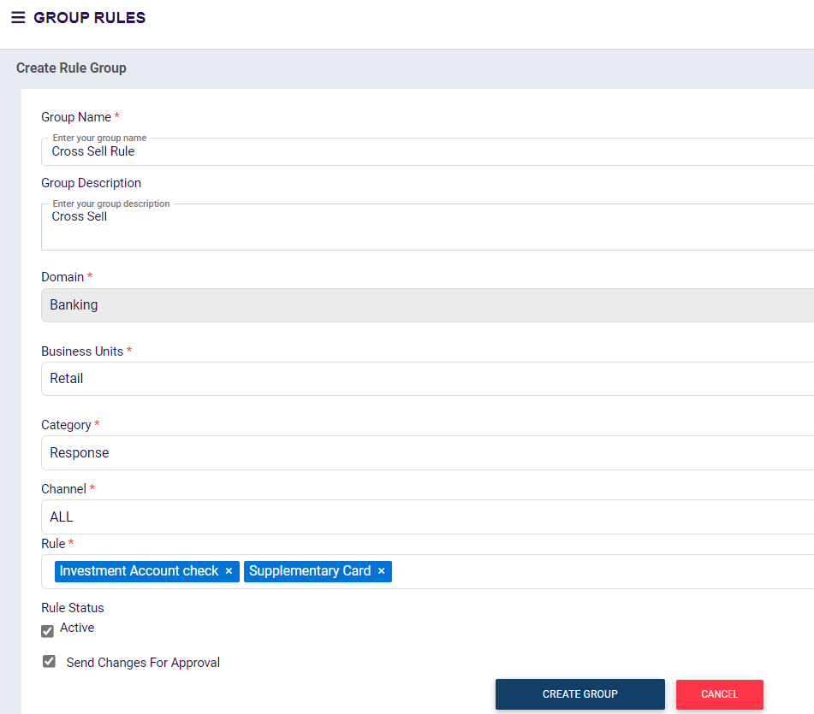
Group Rules – Create New Group Rules
Rules that are created and approved can be Grouped together By Group Rules

Slide 36
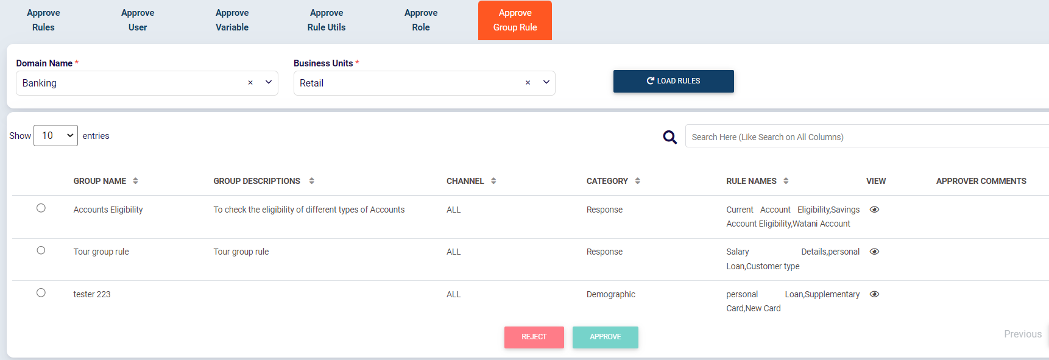
Group Rules- Approval Screen
Group rules can be approved or Rejected by a checker

Slide 37
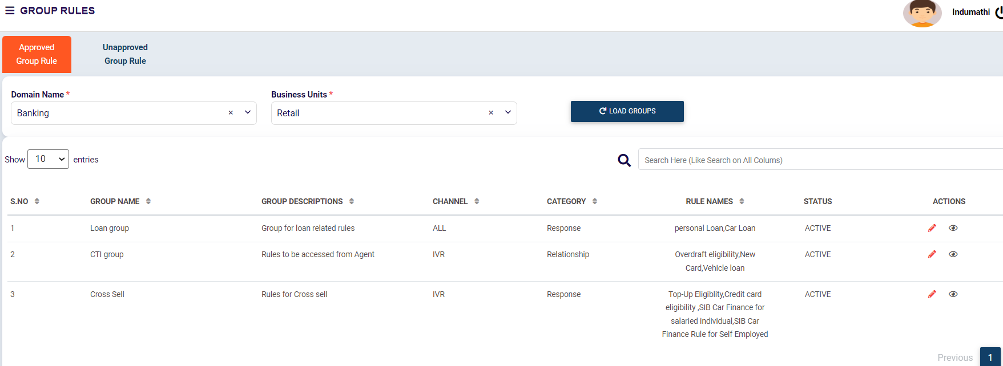
Group Rules- Approved Group Rules
Approved Group Rules can be viewed in this screen

Slide 38
Rule Engine overview
Parameter Management
Rules Management
Rules
Rule Utility
Group Rules
Simulator
Role Management
User Management
Reports

Slide 39
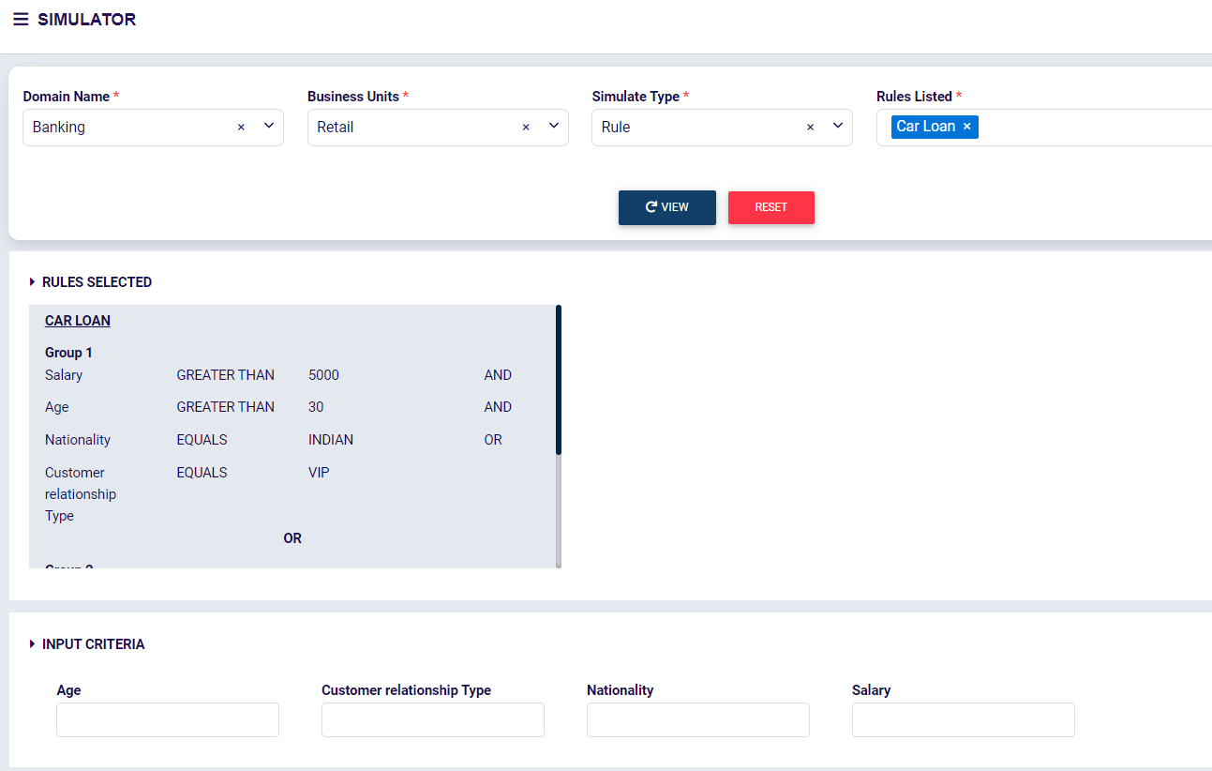
Simulator Screen
Approved Rules/Group Rules/Rule Utility can be executed and verified using this
Simulation screen

Slide 40
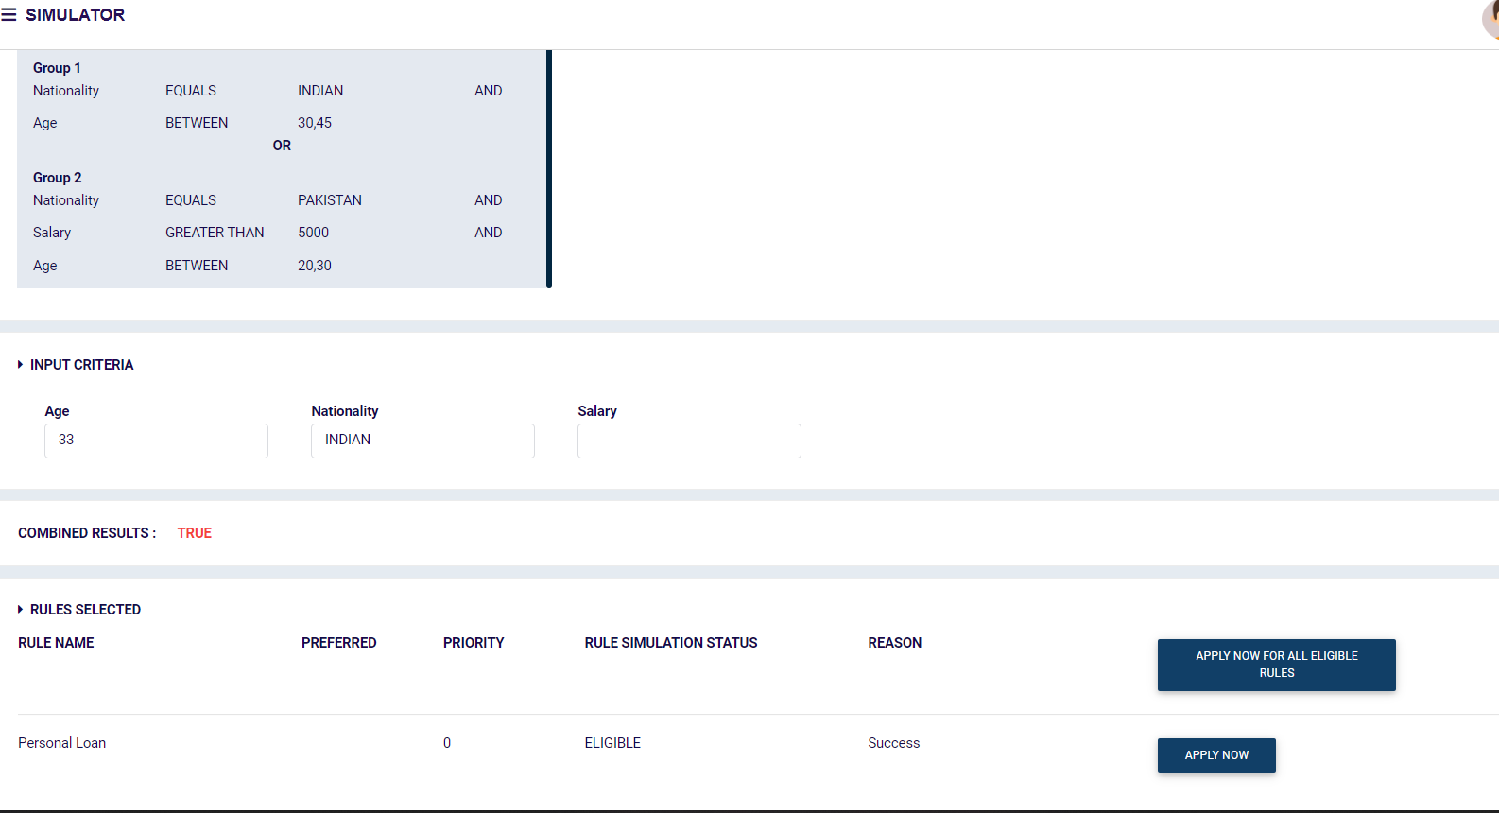
Simulator Screen - Response
When values are passed to rules , Executed rules can be viewed

Slide 41
Rule Engine overview
Parameter Management
Rules Management
Rules
Rule Utility
Group Rules
Simulator
Role Management
User Management
Reports

Slide 42
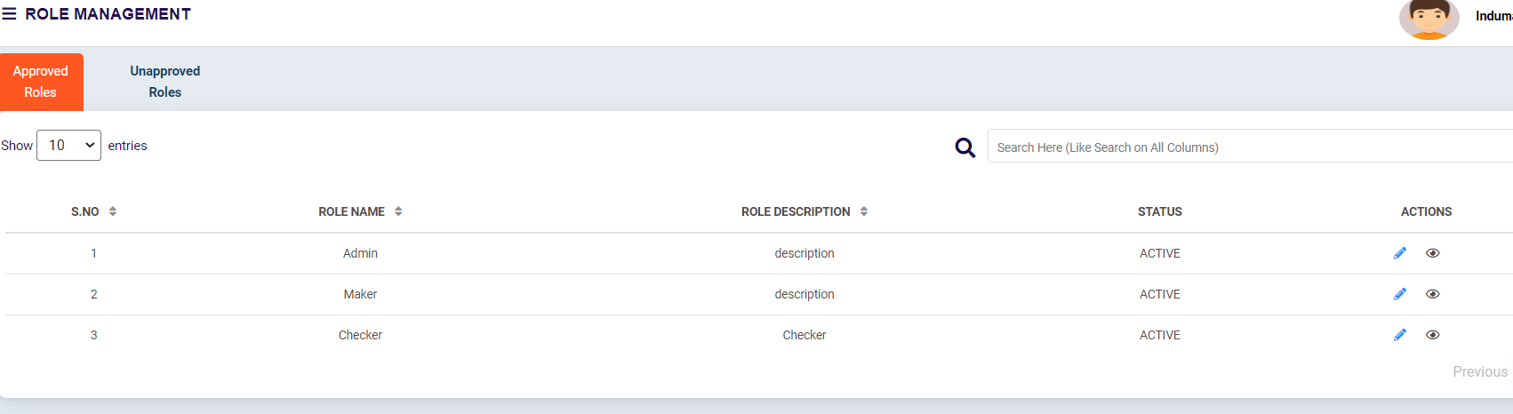
Role Management
Roles can be created and managed by user having appropriate rights

Slide 43
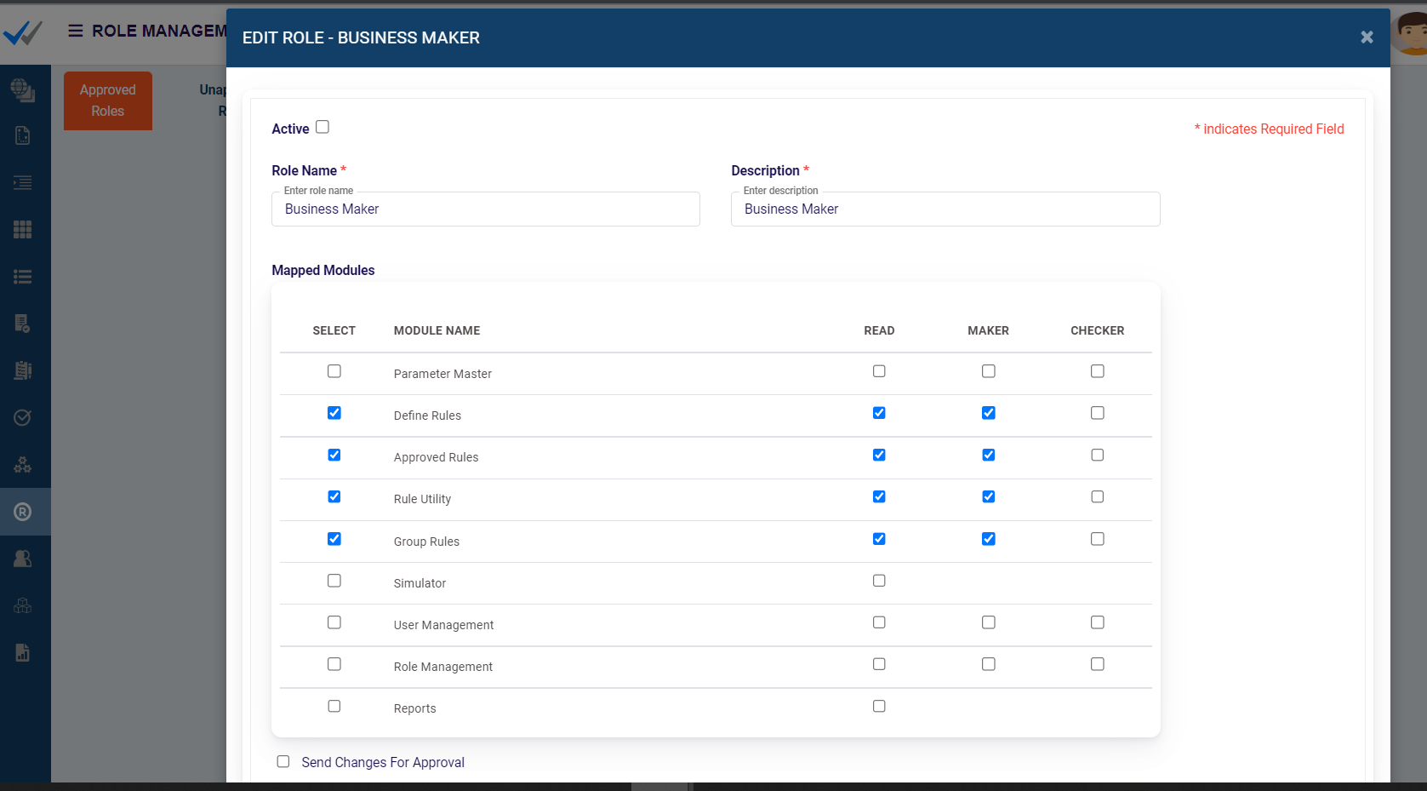
Role Management
Each role can be assigned rights on Read, Maker or checker for each of modules

Slide 44
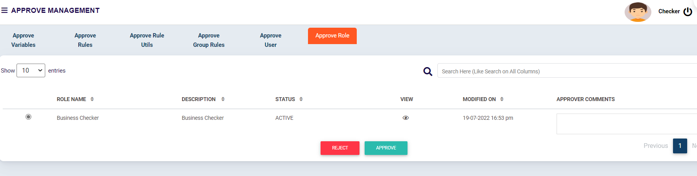
Role Management – Approval
User with checker access can approve / reject the Role created

Slide 45
Rule Engine overview
Parameter Management
Rules Management
Rules
Rule Utility
Group Rules
Simulator
Role Management
User Management
Reports

Slide 46
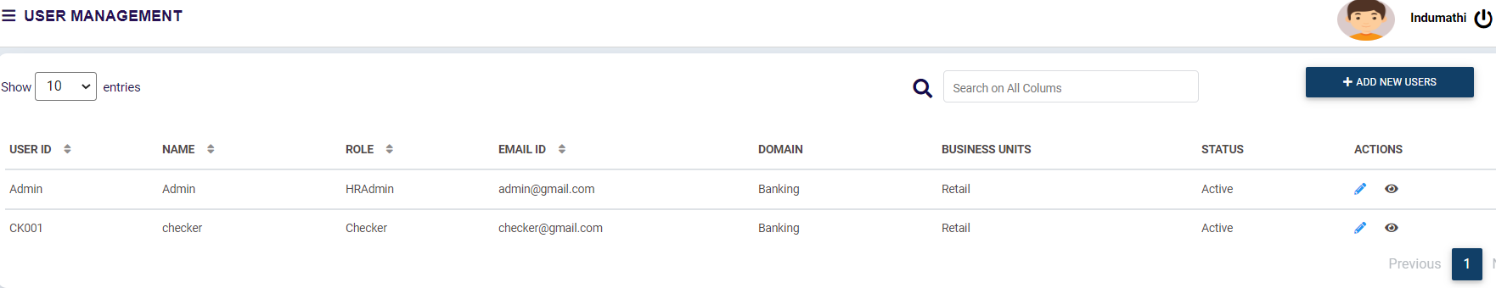
User Management
Users can be added through User Management

Slide 47
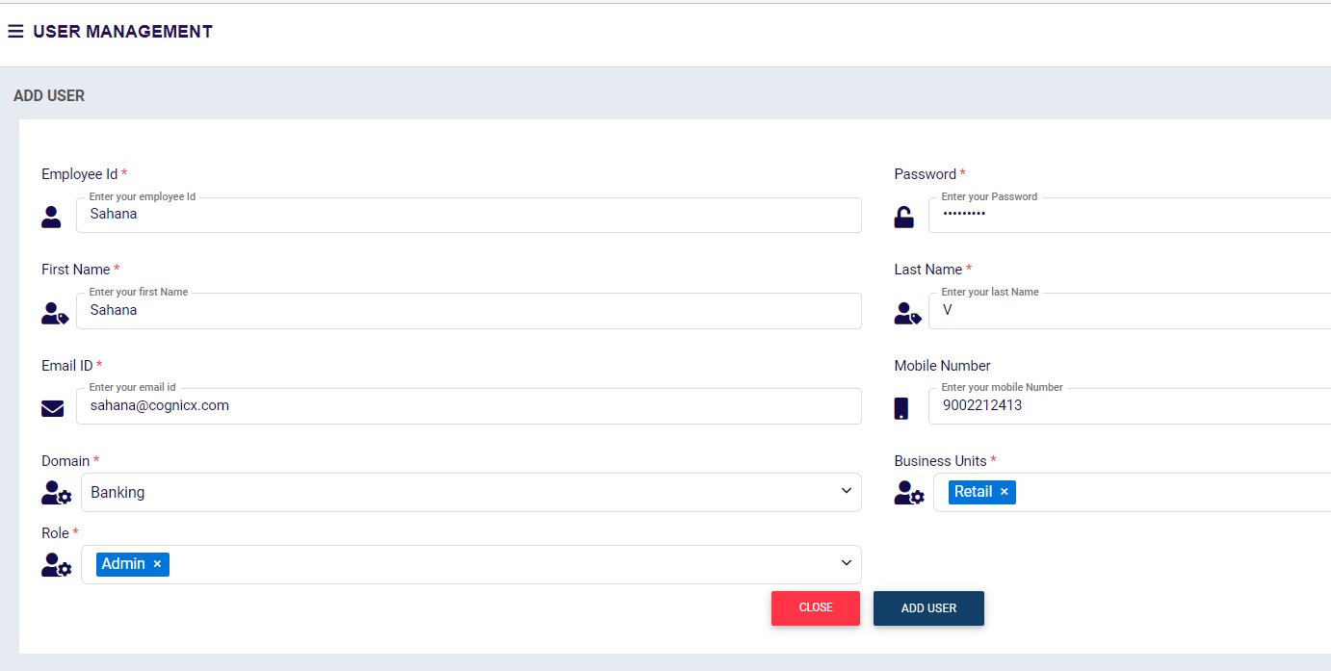
User Management – Add New User
New user can be created by adding New user Id, password along with Role details. Once user created it will be sent for Approval

Slide 48
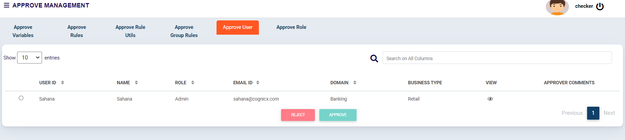
User Management -Approval
User with checker access can approve/Reject the users created

Slide 49
Rule Engine overview
Parameter Management
Rules Management
Rules
Rule Utility
Group Rules
Simulator
Role Management
User Management
Reports

Slide 50
Reports
Number of Rules Configured
Frequently Used Report
Lead Generation Report

Slide 51
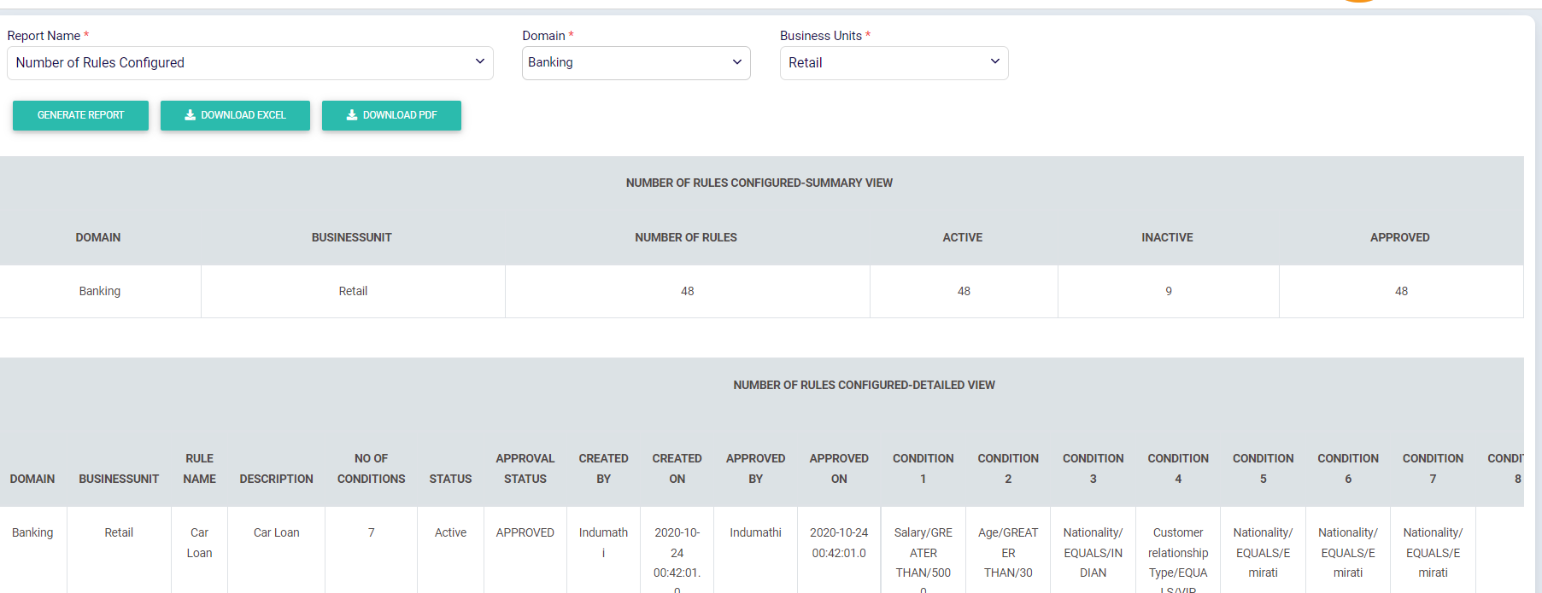
Reports - Number of Rules Configured
Gives details on Active/inactive and approved Rules configured

Slide 52
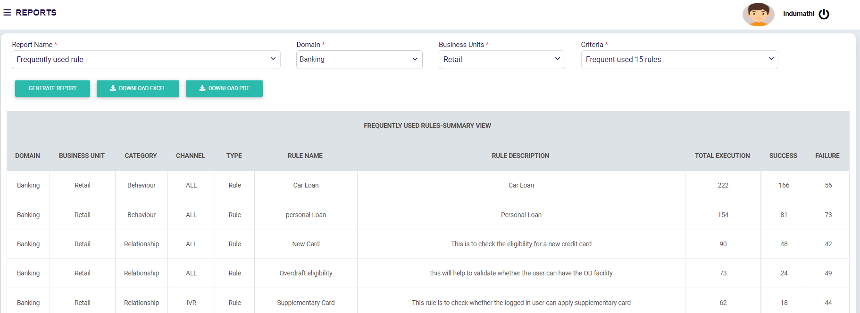
Reports - Frequently used details
Gives details on Frequently used rules based on execution frequency.

Slide 53
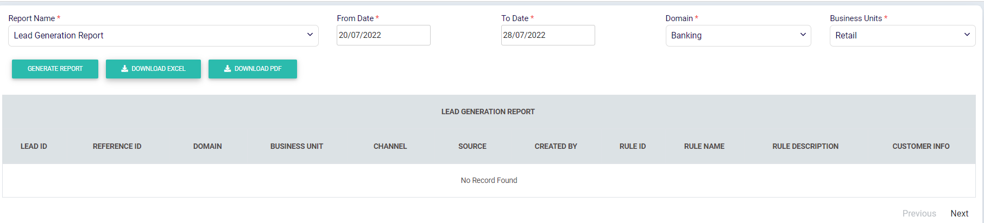
Reports - Lead Generation
Gives details on leads created because of executing the rule. For that whenever rule lead is created , Lead generation API of smart rules should be invoked.

Slide 54
Thank You!

